Slide 1

PACKAGE AND INTERFACE
JAVA & ANDROID

Slide 2
PACKAGES
A package as the name suggests is a pack(group) of classes, interfaces and other packages.
In java we use packages to organize our classes and interfaces.
We have two types of packages in Java: built-in packages and the packages we can create (also known as user defined package).
In java we have several built-in packages, for example when we need user input, we import a package like this:
Import java.util.Scanner
java is a top level package
util is a sub package
Scanner is a class which is present in the sub package util.

Slide 3
Advantages of using package
Java package is used to categorize the classes and interfaces so that they can be easily maintained.
Java package provides access protection.
Java package removes naming collision.
Packages provide reusability of code .
To bundle classes and interfaces.
We can crate our own Package or extend already available Package.

Slide 4
INTERFACE
The interface in java is a mechanism to achieve abstraction.
There can be only abstract methods in the java interface not method body.
It is used to achieve abstraction and multiple inheritance in Java.
Java Interface also represents IS-A relationship.
It cannot be instantiated just like abstract class.

Slide 5
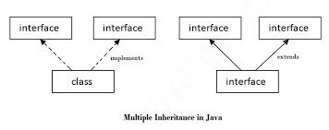

Slide 6
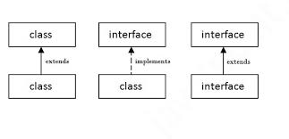

Slide 7
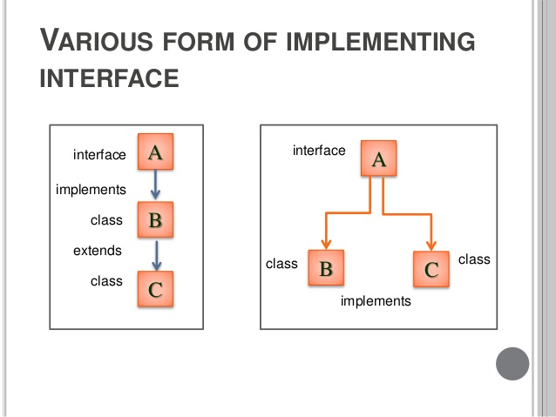

Slide 8
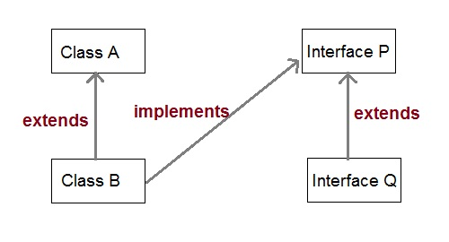

Slide 9
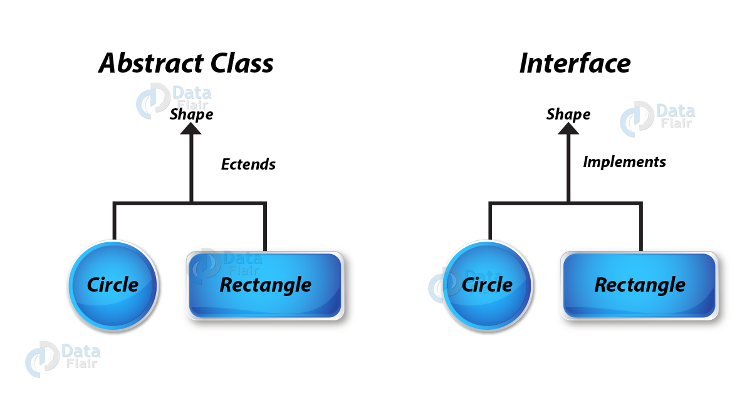

Slide 10
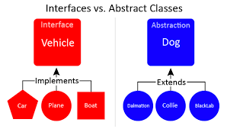

Slide 11
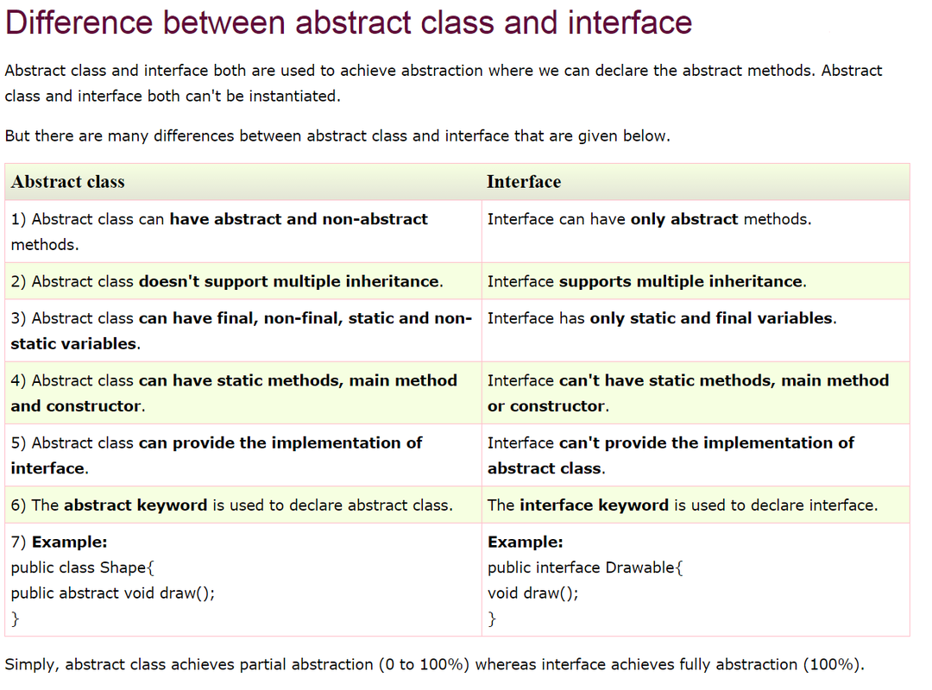

Slide 12
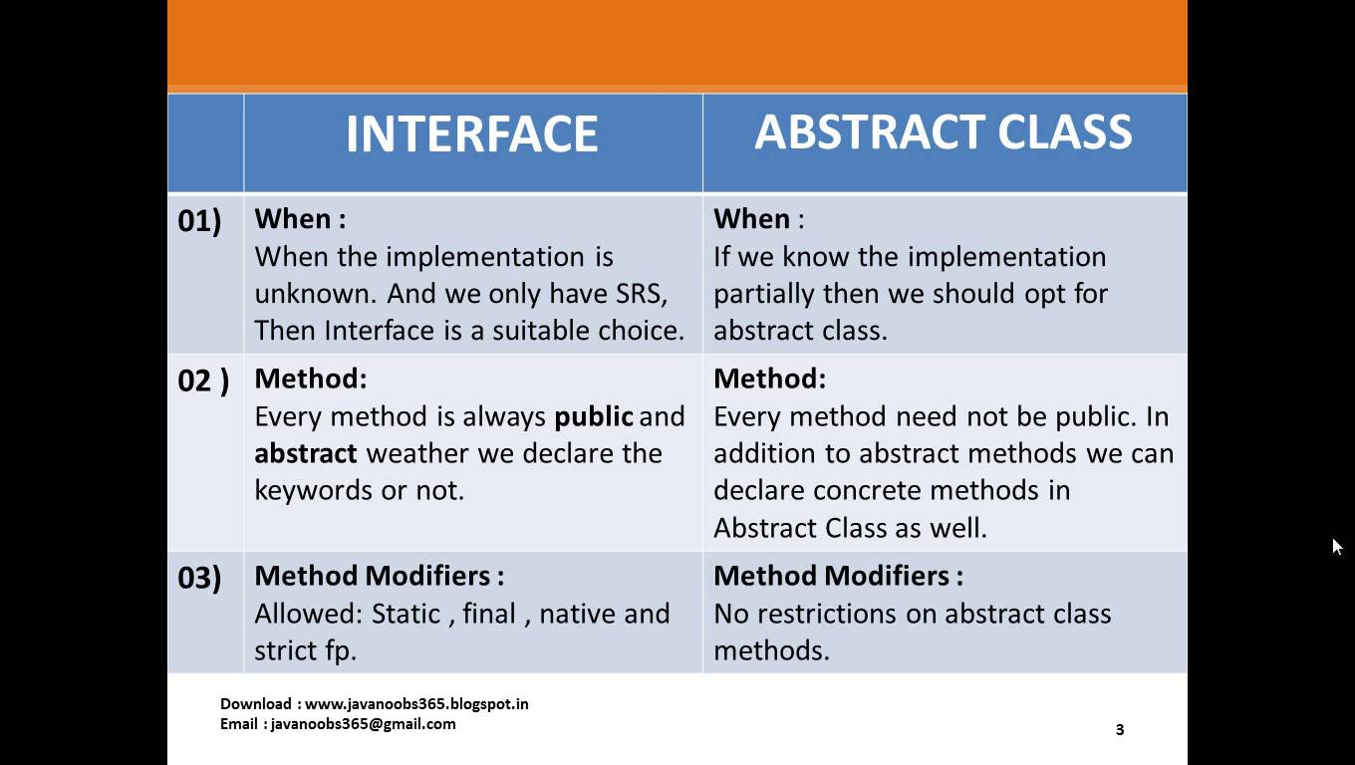

Slide 13
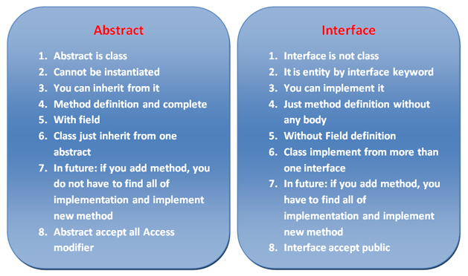

Slide 14
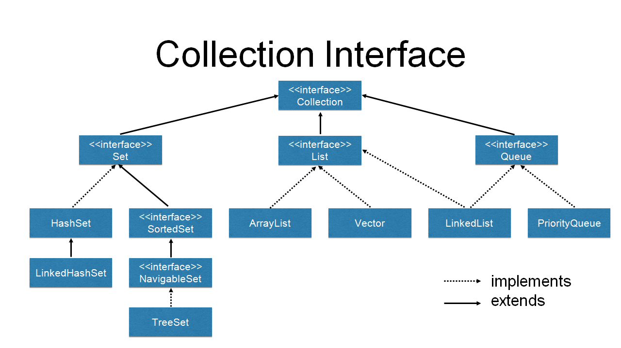

Slide 15
Some keypoints about ARRAYLIST
ArrayList is dynamic data structure in which you can add or remove any number of elements.
The package you required to import the ArrayList is import java.util.ArrayList;
You can define ArrayList as re-sizable array. It means size of the ArrayList is not fixed, it can grow and shrink dynamically.
In ArrayList elements can be inserted at or deleted from a particular position.
If generics are not used, ArrayList can hold any type of objects.
You can traverse an ArrayList in both the directions – forward and backward using ListIterator.
ArrayList can hold multiple null and duplicate elements.
ArrayList provide sufficient methods to work with like Add().

